Slide 1
User Manual
For Automated Panel Solar Array

Slide 2
Hardware Parts List
1 x ECO-Worthy 195W 12V Solar Panel
1 x 6” Linear Actuator DC 12V Reversible Polarity
1 x 12” Linear Actuator DC 12V Reversible Polarity
4 x Actuator Brackets
4 x Cotter Pins
1 x 45” Wide Steel Base
2 x 6” Aluminum Extrusions w/ 45 degree cuts
2 x 16” Aluminum Extrusions
2 x 26” Aluminum Extrusions
3 x 2 Hole Pivot Joint
2 x 4 Hole Tee Joint Bracket Plate
32 x 1/4-20 x .5" Button Head Socket Cap Screw
26 x 1/4-20 Slide-in Economy T-Nut
5 x Flat 2 Hole Joining Plates
2 x 30° 2 Hole Joining Plates
2 x 90° 3 Hole Joining Plates
4 x 3D Printed Photoresistor Integrated Mounts
1 x Watertight Enclosure

Slide 3
Electrical Parts List
1 x Photoresistor Wiring Harness
1 x 12V Battery
1 x Arduino Uno Wifi Rev 2
1 x Solar Charge Controller
1 x 4 Channel Relay Module

Slide 4
Base Assembly
Lay the 45” Wide Steel Base on a flat surface. Using six 1/4-20 x .5" screws and two T-Nuts, fasten the two 4 Hole Tee Joint Bracket Plates to one of the 16” Aluminum Extrusions and steel base. The steel base has threaded holes that do not require a T-Nut.
Secure the two 30° 2 Hole Joining Plates, two 90° 3 Hole Joining Plates and eight T-Nuts. Use two 1/4-20 x .5" screws to fasten each 30° 2 Hole Joining Plate to the steel base. Lineup the two 6” Aluminum Extrusions w/ 45 degree cuts underneath them and against the center strut. Slide a T-Nut on the each side of the 6” Extrusion (except for the underside) to fasten the 30° 2 Hole Joining Plates and 90° 3 Hole Joining Plates to their respective extrusions. Also slide two T-Nuts from the top of the center extrusion on the equator side and one T-Nut on the pole side. Using the top nut on the equator side and the nut on the pole side, affix the 3 Hole Joining Plate.
Affix a 2 Hole Pivot Joint to the top of the center strut so that it rotates from equator to pole (latitude) using two 1/4-20 x .5" screws and a T-Nut to secure a 26” Aluminum Extrusion to the top of the pivot joint, centered.
On the top of each end of the 26” Aluminum Extrusion, fasten a 2 Hole Pivot Joint so that is rotates from east to west (longitudinally).

Slide 5
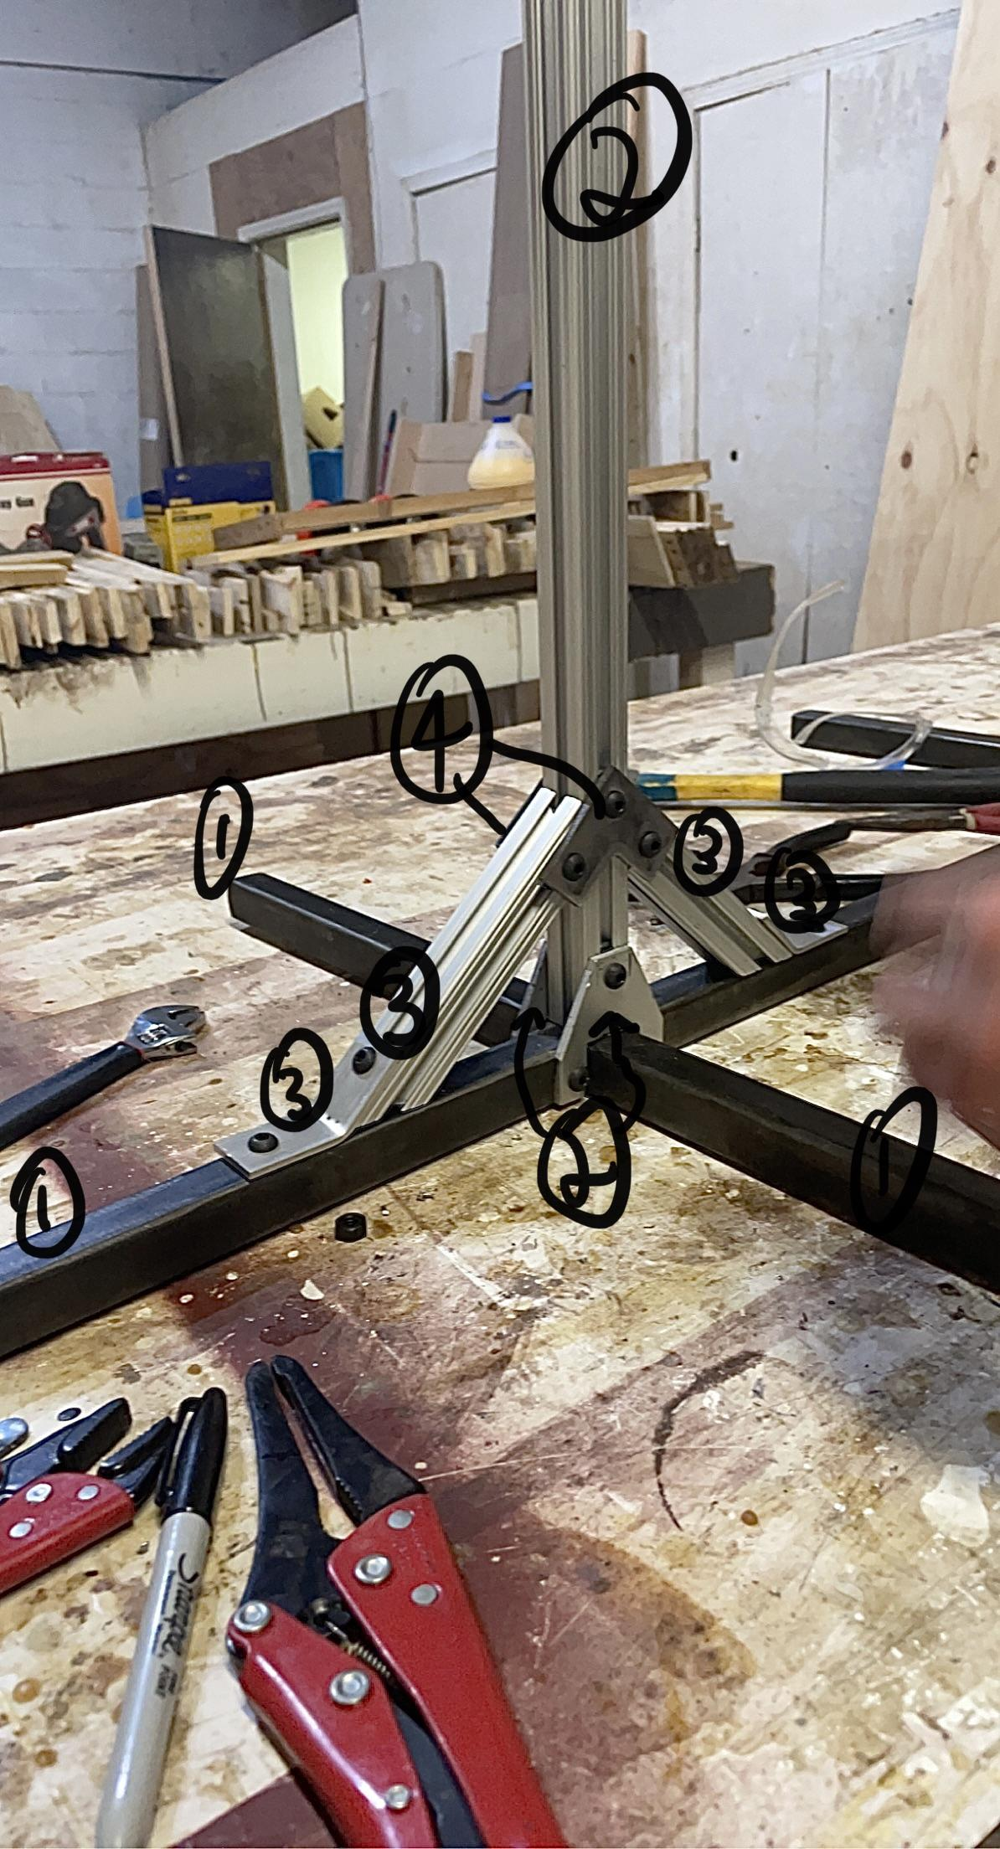
The finish assembly of the base should look like this:

Slide 6
Solar Panel Assembly
Slide the second 26” Aluminum Extrusion into the center of the panel under the underside lips. Use two T-Nuts and two 1/4-20 x .5" screws to combine the base connected 2 Hole Pivot Joints to the Solar Panel. If it is difficult, tighten the nuts on the 2 Hole Pivot Joints to prevent them from rotating.
Using 4 1/4-20 x .5" screws and four T-Nuts, rig the 3D Printed Photoresistor Integrated Mounts to each corner of the Solar Panel on the longitudinal sides.
Connect the wiring harness to the inside strut using zip ties and run the corresponding marked cables to each corner.
Attach the final 16” Aluminum Extrusion to the Pole under side corner of the lower 26” Aluminum Extrusion using a Flat 2 Hole Joint on each longitudinal side with four T-Nuts and four 1/4-20 x .5" screws.

Slide 7
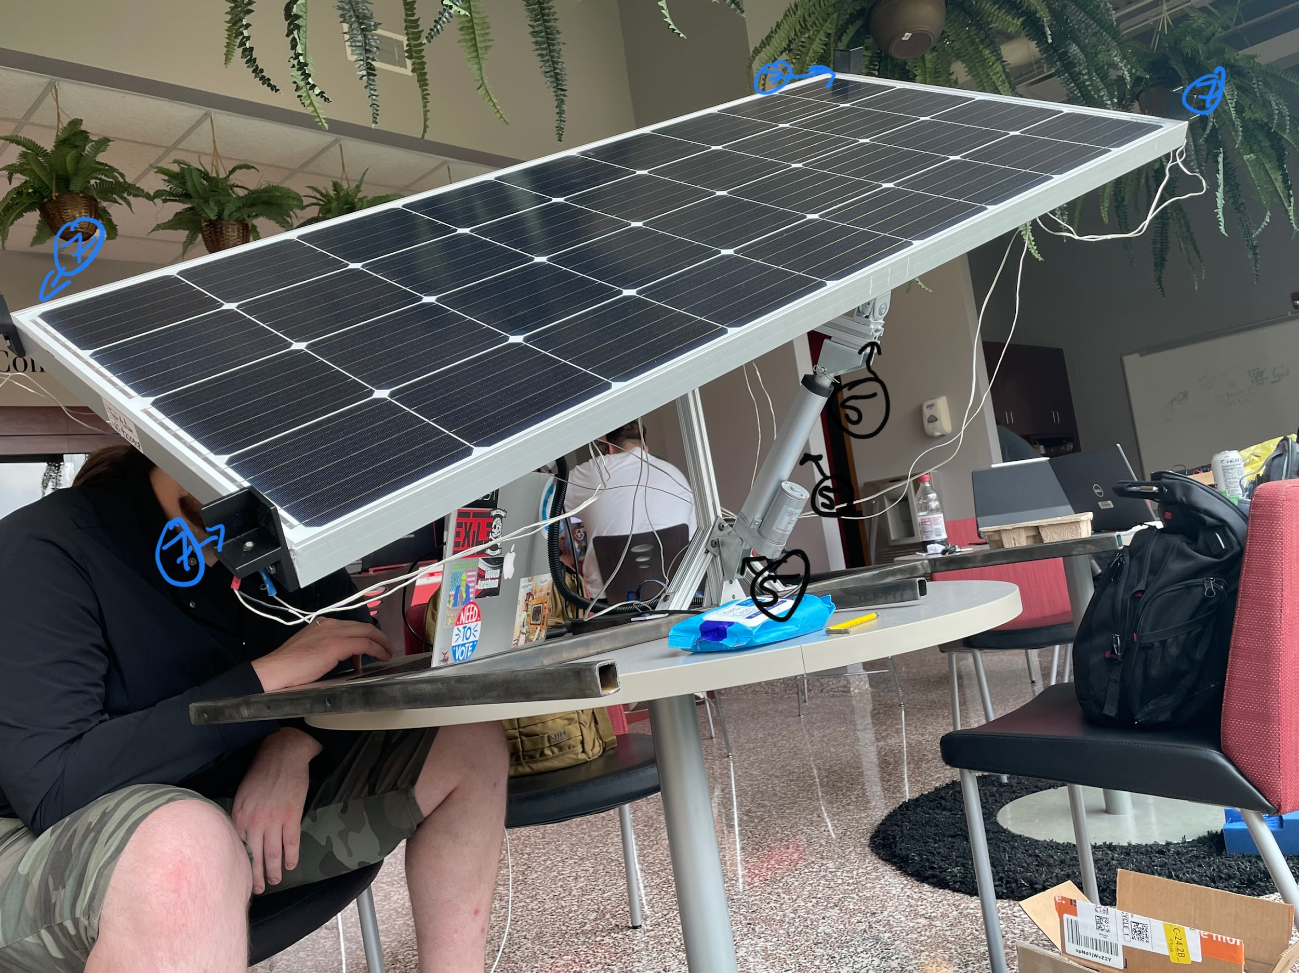
The final assembly of the solar panel should look like this.

Slide 8
Actuator Assembly
Affix the top of the 12” Linear Actuator to the side of the solar panel that has a hole running 9.5” from the end using 2 T-Nuts and 2 1/4-20 x .5" screws.
Affix the base of the 12” Linear Actuator to the side of the 16” Extrusion with two T-Nuts, 2 1/4-20 x .5" screws and a Flat 2 Hole Joint as a spacer.
On the opposite side of the 26” Extrusion, affix the top of the 6” actuator to the bottom end of the extrusion with two T-Nuts, 2 1/4-20 x .5" screws and a Flat 2 Hole Joint as a spacer.
Affix the base of the 6” Linear Actuator to the side of the center post extrusion using one 1/4-20 x .5" screw.

Slide 9
Electrical Installation
Using two T-Nuts and two 1/4-20 x .5" screws, fasten the electrical box to the 16” extrusion on the outer side.
Plug in the corresponding cables from the wiring harness to the underside of the electrical box. Plug in the two solar panel power connectors to the top of the enclosure. They go in only one way.
Plug the usb from the Arduino and lighting strip to each separate USB port from the Solar Charge Controller.
Using Zip Ties, tidy up the cables from the wiring harness and actuators, make sure there are no pinch points and that there is enough slack for movement.

Slide 10
Enjoy Your *Free* Energy!
The Solar Panel assembly is complete! Once the system has power it will need to be connected to a WiFi router with the name “APSU Solar Project” and the password set to “solarproject” To change what network it connects to, open the Arduino IDE and change the ssid and password strings in the Solar_Project_Combined_Codebase.ino

